Slide 1
Presentation 2b
2018 Census
Products & Services
Engagement

Slide 2
Summary of Products & Services Engagement during 2018
• Determine if proposed Products & Services mix meets customer needs
• Outline process for product development and dissemination
• Identify customers’ planned uses of 2018 Census data
Phase 1
Feb
• Determine information / data needs for new census topics
• Identify gaps and determine priorities for targeted engagement around specific topic areas
Phase 2
May-June
• Ensure content development is meeting customer needs
• Engagement connected to audience the product is being produced for
• Opportunity to discuss how products will be presented via the website
Phase 3
June, ongoing

Slide 3
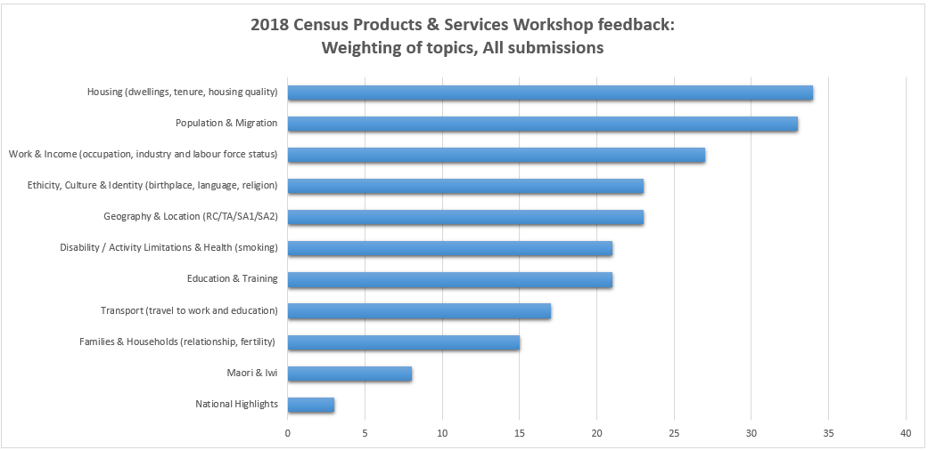
Priority topics

Slide 4
2018 Census Data Releases
First Release of Data
Population and occupied dwelling counts
Second Release of Data
Prioritised topic content
Customised data requests
Electorates Announced
Working with Electoral Commission and LINZ to confirm date
Phased Release of Products
Free Products
- Tabular
Profiles
Maps
Microdata
Metadata

Slide 5
Proposed products and services paper
Table products
  Configurable pre-defined tables
  Small area data sets
Profiles
  Place summaries
  Iwi profiles
  Ethnic group profiles
Summaries and stories
Analytical reports

Slide 6
Microdata
Access to microdata and 2018 Census data
• Strictly controlled access
• Subject to confidentially rules and checking processes
Integrated Data Infrastructure (IDI)
Other Microdata products available:
• Standard datasets
• Longitudinal census datasets
Microdata Products under review:
• No planned CURF
• SURF
Notes:
2018 Census data will also be linked to the IDI as a priority product given the demand for updated and new time series information in the IDI.
Other microdata products incorporating 2018 Census will be available including;
- standard datasets: all census variables including variables related to how the data is processed
- longitudinal census dataset: linking data from 1981–2018 Censuses.
Microdata Products that have been reviewed: due to low uptake and low ‘usefulness’ scores:
- A CURF is a Confidentialised Unit Record File: a sample of unit record data modified for confidentiality while maintaining integrity of the data. The 2013 Census CURF was based on a 5% sample of respondents. The uptake of the 2013 Census CURF was very low (the 2nd lowest usefulness score in a recent review). This may be due to our existing microdata products better serving the needs of researchers. For this reason, it is not proposed that we will produce a 2018 Census CURF.
- A SURF is a Synthetic unit-record file: generated using statistical techniques to give similar characteristics to respondents, to give insight into relationships between variables, but still prevents unintentional disclosure of individual identity. As with CURF, this product has had a low uptake (lowest usefulness score in the same review of microdata products). Before we commit to producing a SURF for 2018 Census we want to explore ways to make this product more useful. What supporting information (for example, sample exercises, R packages, metadata) would increase the SURFs usefulness?

Slide 7
Services
Customised Data Services
Census Customer Relations
Information Services
  Tables designed specifically for a research project or customer need
  Cost
  Data can be
  pre-ordered
  Our Information centre staff know what information is available, where it can be found and how it can best be used
• Census enquiries
• Census requests
• Census Advisory Newsletter
• External Data Quality Training
• External engagement
Notes:
Customised data services
Customised tables are designed specifically for a particular research project. They only contain the population and variables of interest, at the level of detail requested (or granted).
There is a cost based on an hourly rate for customised data services. We encourage users of customised data services to collaborate with each other on joint data requests, to reduce costs. Customers can pre-order data to speed up delivery after release.
Information services
Our Information centre staff know what information is available and how it can best be used. Contact details for the Information centre are available on our website.

Slide 8
Disability information
Phase 1 engagement identified Disability as of needing engagement due to its status as new content, in order to understand the most suitable way to produce products for this topic
Established priority sub-themes identified:
  Core demographics (age, sex, ethnicity)
  Work (Labour force status, income)

Slide 9
Phase 2 engagement
Determine information / data needs for new census topics
Identify gaps and determine priorities for targeted engagement around specific topic areas
How:
  Online engagement - Loomio
  Face-to-face engagement
There will be on-going opportunities for input into further content development and product development throughout 2018

Slide 10

LOOMIO (loomio.org)
Loomio is an online facilitation tool which will enable:
  Fewer face-to-face meetings and emails
  Better decision making together
  Immediate responses and interaction
  Creation of polls and ranking exercises
  Sharing information and documents
You will be sent an email inviting you to join the Loomio – 2018 Census housing group

Slide 11
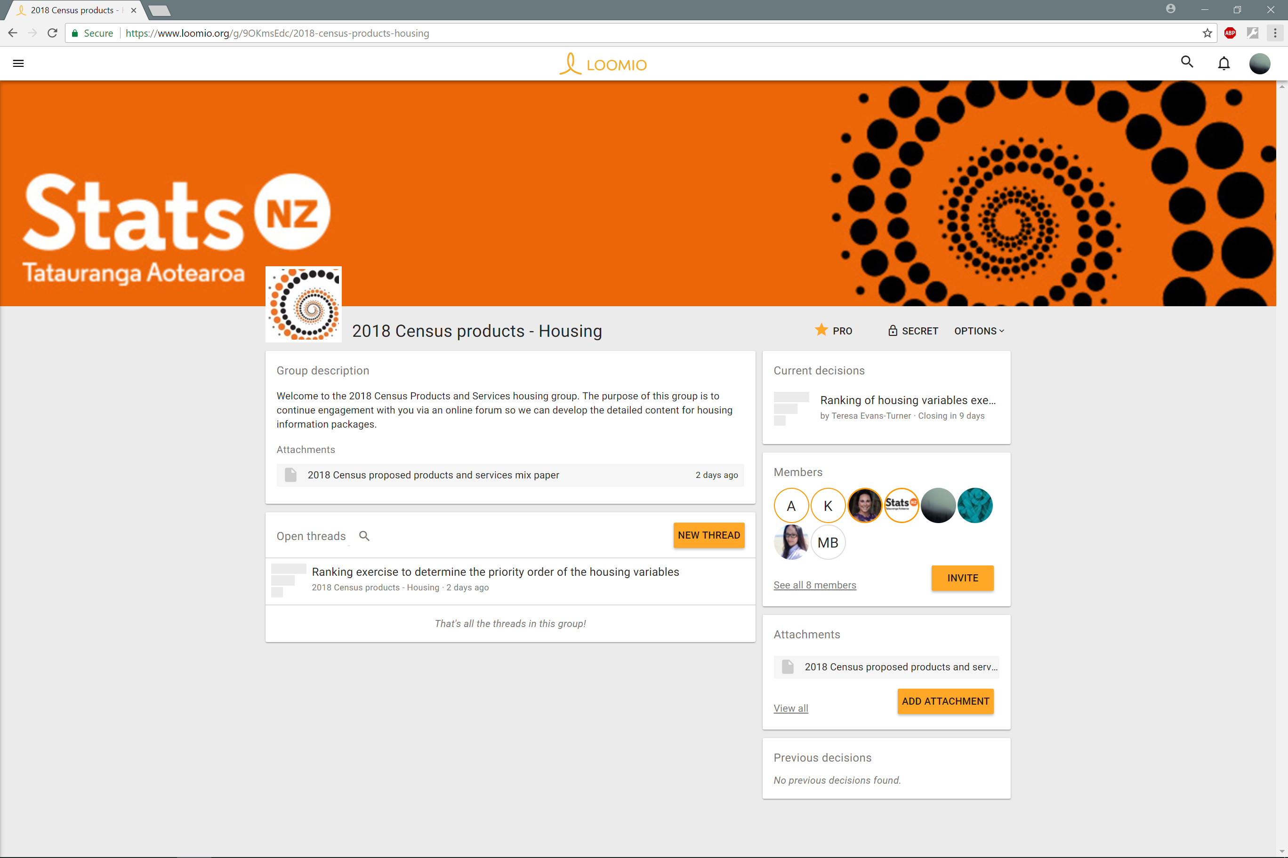

Slide 12
